Slide 1
Bees

Slide 2
Environmental Ethic
Because humans are responsible for ecological crises, human endeavors should be conducted in a way that ensures the sustainability and flourishing of both humans and the environment as a whole.

Slide 4
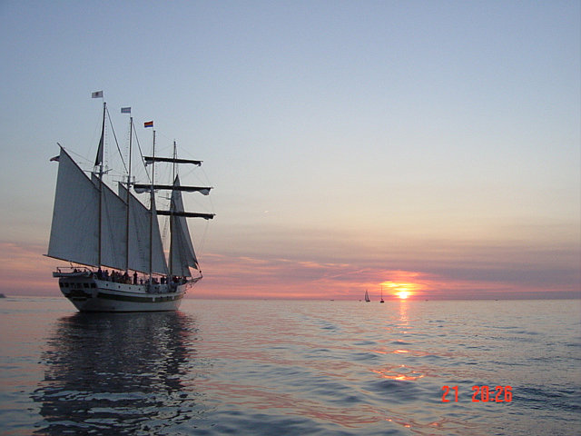
ANTHROPOCENTRIST ENVIRONMENTALISM: “SPACE-SHIP” EARTH

Slide 5
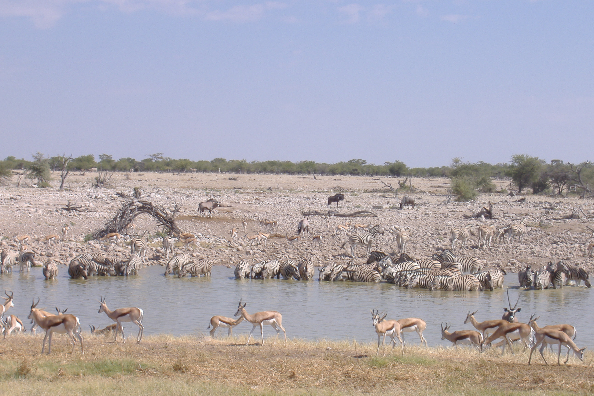
ECOCENTRIC ENVIRONMENTALISM: “community” earth

Slide 6
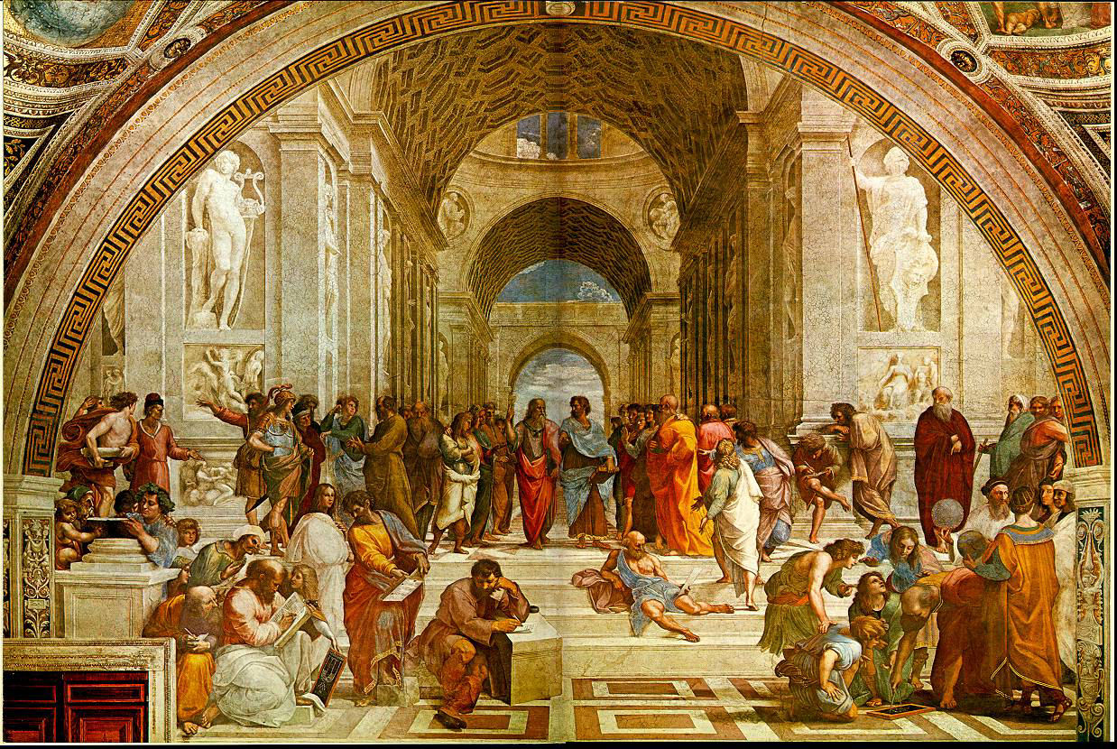
DEONTOLOGICAL EUDAIMONISM

Slide 7
Four Duties
…must be met if the ethical formula is to be adhered to.
to the future—both human and the rest of nature
to the environment, or the earth’s ecosystems
to communal human flourishing, esp. the poor
…and, directed particularly to those who benefit most from the practices which cause environmental destruction…
the duty to suffer for the sake of the greater good.

Slide 8
Shades of Green
The shades of green represent the grades we are going to give
Forest green represents the highest score that the campus is able to receive if it has an “outstanding” performance in implementing green campus practices.
Emerald green represents a “good” score. The campus is almost currently attaining fully green campus status.
Lawn green represents a “moderate” score. It means that the campus promotes actions that neither harm nor help the environment.
The olive green represents a “satisfactory” score. The score means that the campus acts only in a minimal passing level.
Sea green is the lowest score that the campus can get. This means that a campus fails to implement any initiative of being green. Its performance is “poor.”

Slide 9
DUTY TO THE FUTURE To ensure the sustainability of future generations and ecosystems, we ought to develop guidelines that follow “a maximum of … imposed social discipline [that] can ensure the subordination of [the] present advantages to the long-term exigencies of the future” must be developed (Jonas 142). Our duty to the future develops the following changes that ought to be made: ensure the sustainability of humankind and ecosystems, reduce consumption of resources, and increase investment in alternative energies. By making these changes, our generation will be able to effectively reduce our carbon footprint and pass on the resources that were given to us from past generations in an equal, if not better, state. Along with passing down the resources that were given to us, our generation will pass down the knowledge and moral ability to take care of the planet and continue the efforts at revival of ecosystems.

Slide 10
Duty I to the Future
0 Points |  | 1 Point | 2 Points | 3 Points | 4 Points | Points Acquired
Is the client using sustainable resources?
-Irreparable damage to the environment | -Short term harm that can be remediated |  | -No harm, No good | -Manage for Health | -Ecosystem functions autonomously
Is the client consuming more resources than necessary?
-Excessive Over-consumption | - Over-consumption |  | -No Reduction in Consumption | -Reduced Consumption by 10-15% | -Reduced Consumption by 15% or more
How much of the client’s income is being budgeted for alternative resources?
-No investment or changes made to use alternative energy | -1% to 4% of income invested for alternative energy within ten years |  | -5% to 9% of income invested for alternative energy within ten years | -10% to 14% of income invested for alternative energy within ten years | -15% to 20% of income invested for alternative energy within ten years

Slide 11
Duty to nature
Humans and the environment, by following the laws of nature, pursue excellence ,or a state of flourishing.
The flourishing of the environment can be defined as “ecosystematic perfection.”
Humankind’s state of excellence is “to act according to reason, and this is to act according to virtue... all acts of virtue are prescribed by natural law, since each one’s reason naturally dictates him to act virtuously”(Aquinas: ST I.II.94.3).
According to natural law, then, nature as nature is viewed as being excellent and humankind should act according to reason. It is therefore unreasonable for human beings to act against natural law by doing anything which upsets the flourishing of nature (measured here as ecosystem health).

Slide 12
Duty II to the Environment
0 Points | 1 Point | 2 Points | 3 Points | 4 Points | Points Acquired
Is the client utilizing recycling and reusing programs and products?
-Actively consume non-recyclable or reusable resources. (large quantities) -No recycle or reuse programs available. -Complete disregard for possible recycle or reuse programs | -Very little done to recycle or reuse. -Few programs in place to aid or promote recycle or reuse. -Programs available are not used efficiently | -Recycle programs fairly decent. -Reuse programs (if any) are sub-par -No real threat to environment, but also no great aid to environment | -Provides facilities for recycle and reuse. -Promoting reuse applications with small outcomes | -Actively promoting reuse applications. -Facilities in place, majority cooperation. (incentives-Maybe) -Emphasizes reuse. Almost majority of materials used are reused and or recycled
What is the client’s environmental impact?
-Negatively affects environment so environment can no longer function with any sense of normality. -Actively takes away from ecosystem health (takes away diversity) | -Very little done to recycle or reuse. -Few programs in place to aid or promote recycle or reuse. -Programs available are not used efficiently | -Neither helping, nor damaging -Some (small) action against environmental degradation | -Attempting to positively aid environment. -Some level of action taken to aid in ecosystem health | -Positively promoting environment. -Aiding in sustainability. -Aids in diversifying ecosystem (ecosystem health)
What waste is the client producing and how is the client managing the waste?
-Actively wastes products. (contributes highly to land fills) Significant damage caused by excessive waste | -Little to no action to prevent or stop waste. -Actively degrades environment | -No major production of waste -No operational programs are in place to stop or prevent waste -Small negative environmental impact | -Little to no waste Prevention of waste in effect. -Waste does not negatively affect environment on a detrimental level | -NO WASTE -Takes positive action against wasting of renewable products. -Contributes to environmental health

Slide 13
Duty to human flourishing
The definition of human flourishing is establishing a good life based on “developing our higher capabilities” and not focusing on “status seeking and increased consumption” (Cafaro 17).
We must simplify our lives.
We should spend our time in acquisition of knowledge and wisdom, challenge ourselves to become better people by making sacrifices and accepting responsibility for our actions. This will lead us to true happiness and provide true human flourishing.
The greater the attention that we pay to our true happiness, the more that will be done to protect the environment.

Slide 14
Duty III to Humans
0 Points | 1 Point | 2 Points | 3 Points | 4 Points | Points Acquired
Does the client provide opportunity for environmental education?
-Promotes a false understanding of the environment | -Deprioritizes environmental education | -Neutral | -Provides an opportunity for people to be educated about the environment | -Provides Academic credit. -Provides CEU credit -Provides bonus credit
Does the client allow for basic human needs?
-Prevents access to basic human needs | -Fails to provide for basic human needs | -Neutral | -Provides people some of their basic needs | -Provides people all of their basic needs
Does the client allow others an equal opportunity to flourish?
-Prevents others from flourishing | -Does not allow others to flourish | -Neutral | -Allows some to flourish to some extent without impacting others | -Allows many to flourish without impacting others

Slide 15
Duty to suffer
Voluntary suffering is not something most people would embrace, but both Kant and Aquinas agree that it is both “our duty as humans to suffer for the greater good” (Kant) and that the “beatitude”, or highest level of love, would require an individual to make sacrifices in order to help another (Aquinas). As rational creatures, we have the ability to put the needs of others before our own and because we can, we must. Otherwise, we are only animals vying for our own survival and to be the head of the pack.
the privileged few will not suffer as much as people who already are suffering in regions of the world where ecological crises are at their worst. For instance, 26 million people could be fed if the amount of food wasted in the United States each day were reduced by one third.
Simply put, those who are suffering now don’t have much more to sacrifice, and we have much that we could do without. Through doing so, we benefit the planet. (WorldWatch Institute. Matters of Scale: Food For Thought)

Slide 16
Duty IV to Suffer
0 Points | 1 Point | 2 Points | 3 Points | 4 Points | Points Acquired
Does the client’s action affect health?
-Causes chronic health problems | -Causes acute health issues | -No impact on health | -Encourage positive health choices | -Actively promote positive health choices.
Does the client’s action affect the quality of life ?
-Promoting poor quality of life | -No actions to improve quality of life | -Short term changes to improve quality of life | -Encouraging positive choices to improve quality of life | -Making long-term Commitments to improve quality of life
Is the client investing in economic green investments?
-Investing in products that harm the environment | -No green investment | -Encouraging green investment | -Short term green investment | -Offering incentives for long-term green investment

Slide 17
Environmental Ethic
Because humans are responsible for ecological crises, human endeavors should be conducted in a way that ensures the sustainability and flourishing of both humans and the environment as a whole.

Slide 18
PRIMARY SOURCES Thomas Aquinas: Summa Theologicae Hans Jonas: An Ethic of Responsibility Immanuel Kant: groundwork of the metaphysic of morals worldwatch institute

Slide 19
The rubrics for our environmental ethic were applied to five general areas of the campus

Slide 20
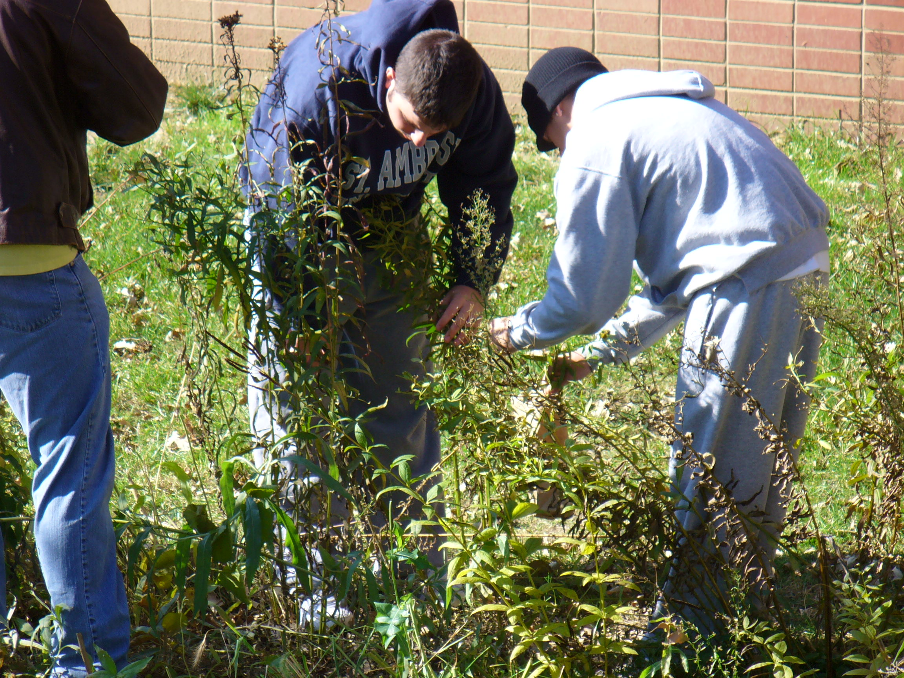
1.) EDUCATION

Slide 21
Energy
Geothermal Heating
Solar Energy
Wind Energy

Slide 22
3.) Physical Campus
groundskeeping & maintenance
stormwater management
porous parking
green roofs

Slide 24
.
4.) Products
Natural and organic food products
Green packaging
Recycled paper, mulch, fencing, furniture, planters, mosaic tiles, carpet, insulation, piping, timber, handrails, sheet rock, lamps, light fixtures
bathroom products & cleaning supplies.

Slide 25
5.) Policies
meal plans
parking policy

Slide 26
summary statements
The project presented here by the Green Bees Environmental Ethic Consultants (GBEEC) is based on the premise that holds “Humans are responsible for ecological crisis,” and “human endeavors should be conducted in a way that ensures the sustainability and flourishing of both humans and the environment as a whole.” This statement provides an ethical justification for the Land-ethic maxim that “a thing is right when it tends to preserve the integrity, stability, and beauty of the biotic community. It is wrong when it tends otherwise.”
This project created an ethical instrument with clear and measurable rubrics applicable to the environmental impact of a client. As stated, the rubrics of the instrument are defined from the four duties that contribute to the GBEEC ethical statement. The duties are Duty to the Future (I), Duty to the Environment (II), Duty to Human Communities (III), Duty to Suffer and Sacrifice (IV). Three rubrics were derived for each duty category. All rubrics are described in text.

Slide 27
The first client GBEEC evaluated with this ethical instrument was St. Ambrose University (Davenport, IA).
The total grade earned by SAU was 17.283.
Below are calculated scores for the eleven areas assessed for SAU by GBEEC:
Education: 22/28
Geo-thermal heating: 7/32
Solar energy: 9/36
Wind energy: 2/28
Groundskeeping and maintenance: 5/20
Storm water management: 31/40
Porous parking: 9/28
Green roofs: 5/28
Products: 14/36
Meal plan: 9/32
Parking: 5/32

Slide 28
Most importantly, the GBEEC model applied to SAU produced several recommendations to help SAU reduce the negative impact of campus polices and infrastructure. Recommendations include such diverse strategies as developing a new meal plan policy to discourage overconsumption, installing porous parking in all new lots, retrofitting green roofs, and many other ideas.
As the Green Bee Environmental Ethic Consultants, it is our prerogative to apply the environmental ethics assessment tool to our own campus: St. Ambrose University. It is our hope, however, that it will be applied to college campuses across Iowa. The ethical instrument’s 12 rubrics, which reflect the four duties derived from our ethical formula, serve as a guide in establishing a “green campus” initiative. This high goal trumps all others if we wish to reduce or even eliminate our carbon footprint.

Slide 29
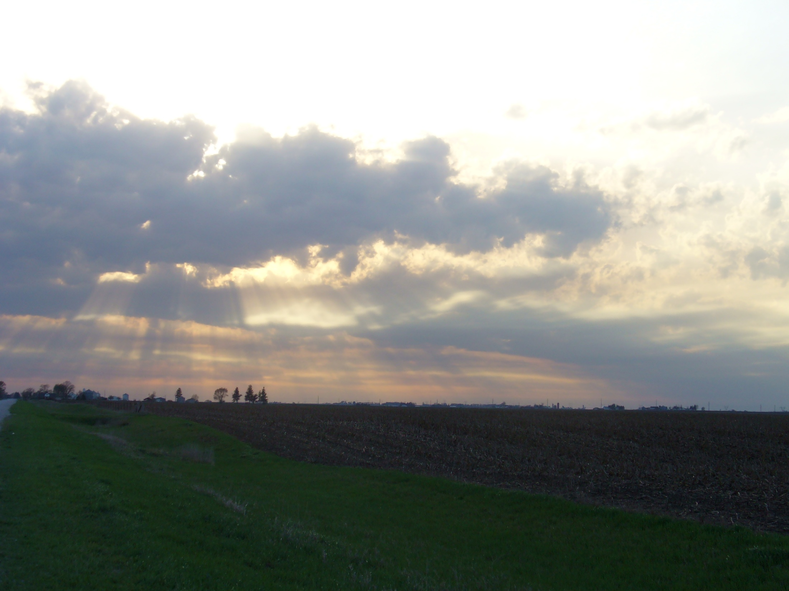
A final note Redistributive Sacrifice for the greater good
Most environmentally ethical duties will not “pay back” as if on the investment: we must do them anyway. To pursue only strategies that are economically expedient is to fail, both practically and morally.
Distinguish between ‘standard of living’ and ‘quality of life’
To care for anything is to accept the responsibility to put its good ahead of one’s own
Ecological crises are so many, and so profound that they cannot be resolved without human suffering
Deliberate, loving suffering, it turns out, is not only beneficial to nature, but is the fullest expression of our humanity: the highest good.

