Slide 1
QUAD CITIES INTERCOLLEGIATE SUSTAINABILITY SUMMIT
Black Hawk College
Dr. Todd Linscott
linscottt@bhc.edu

Slide 2
Its not easy being green
Changes in consumerism
Planned obsolescence
Changes in corporate models
Pace of technology
Paradigm shift

Slide 3
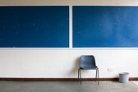
Recycling on Campus
Act 415 ILSC 20/3.1 (Institutions of Higher Learning)
By 2000 40% reduction in waste generated (1987)
Land Fill pickups dropped by 50 percent
Recycle old ceiling tiles/buy recycled products
Construction debris (by contact)
Areas to improve?

Slide 4
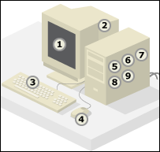
MONITORS $10 and up "events have lower prices"
DEAD OR BAD MONITORS or working monitors alone $10 each
COMPUTERS AND PARTS "NO FEE"
Playstations, X-Boxes, WII, X-box 360, PS-2, PS-3, And even older gaming systems are accepted. "NO FEE"
Laptops / Notebooks / touchpads "NO FEE"
CELL PHONES AND CELL PHONE CHARGERS "NO FEE"
COMPUTER PARTS MISC "NO FEE"
PRINTERS "NO FEE"
SCANNERS "NO FEE"
COMPUTER & NETWORK WIRES $FREE
SATELLITE RECIEVERS & DISHES PARTIAL OR WHOLE "NO FEE"
GPS UNITS "NO FEE"
PORTABLE GAME CONSOLES "NO FEE"
CREDIT CAR TERMINALS "NO FEE"
SECURITY CAMERAS "NO FEE"
DVR'S "NO FEE"
SECURITY CAMERA RECORDERS "NO FEE"
PDA PHONES "NO FEE"
1: Lead in cathode ray tube and solder 2: Arsenic in older cathode ray tubes 3: Selenium in circuit boards as power supply rectifier 4: Polybrominated flame retardants in plastic casings, cables and circuit boards 5: Antimony trioxide as flame retardant 6: Cadmium in circuit boards and semiconductors 7: Chromium in steel as corrosion protection 8: Cobalt in steel for structure and magnetivity 9: Mercury in switches and housing

Slide 5
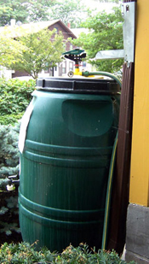
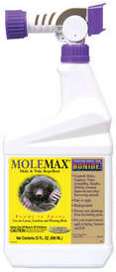
Campus Grounds
Use of rain barrels for plantings
Reduced/eliminated potable water use
Use of native plants for tough areas.
Use of caster oil for moles
Testing corn meal gluten for seed germination inhibitor
Compost all yard and animal stall waste
For use on campus and free to public
GAST grant

Slide 6
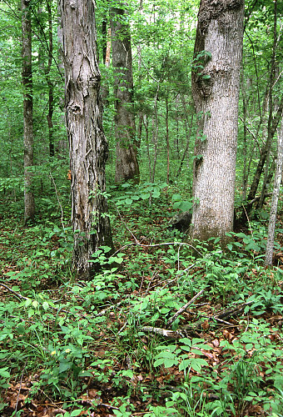
Campus Grounds “Life on the Edge”
Restoration of biological diversity of campus
Initially planted 1500 small trees and shrubs
Reduced mowed/ “biological desert” areas on campus
Increases small mammal/bird population
Typical forest six dominant tree species, 10 to 20 understory species, 100 + herbaceous plants.

Slide 7
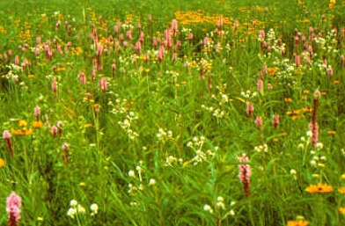
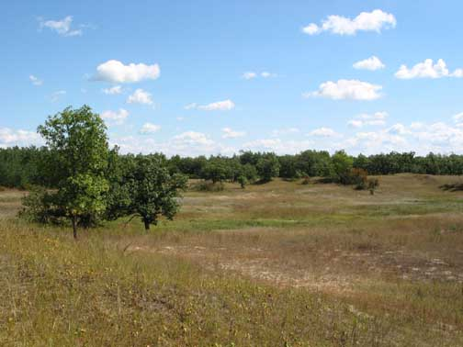
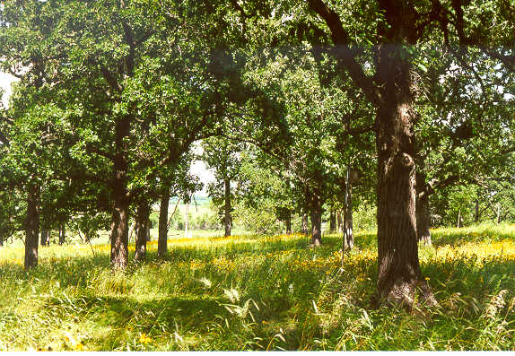
Oak Savanna/ Tall Grass Prairie Restorations
Tall Grass Prairie
Increase diversity of native species
400 + species
Increase water use efficiency
Lower intensive maintenance
Oak Savanna

Slide 8
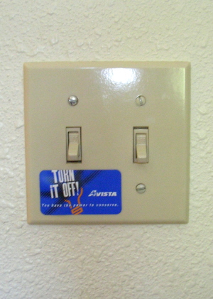
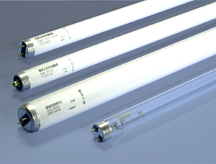
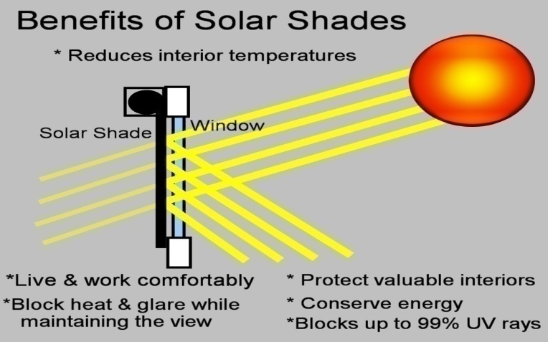
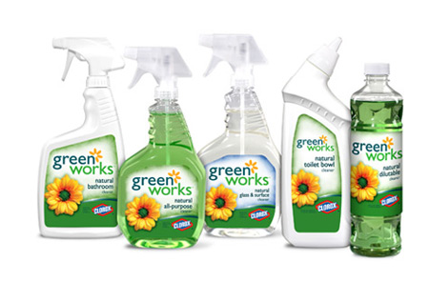
Campus Buildings
Recycled carpet
Lighting upgrade
-T12 to T8 bulbs 30% reduction
-Motion detection in rooms
UV limiting shades
Use of low VOC Paints
Green cleaning supplies
Boiler upgrade (50 to 85% increase)
Water saving ½ gallon urinals 1 gallon flush toilets
Mid-American energy audit

Slide 9
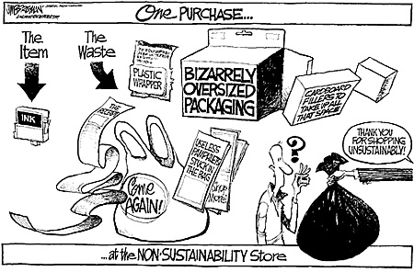
Curricula: Sustainability “GREEN” Supply Chain Courses
Leading-edge education about sustainability and “green” topics
Sustainability to practice green living, remain current in the workplace, or meet the needs of your business customers.
Companies need information about being sustainable to practice social responsibility, remain competitive, or meet the needs of global markets.
Online Classes (10 Hours)
Green Purchasing Fundamentals
Sustainability 101 & Corporate Social
Responsibility Essentials
Carbon Strategies
Life Cycle Assessment for Designers

Slide 10
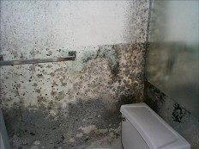
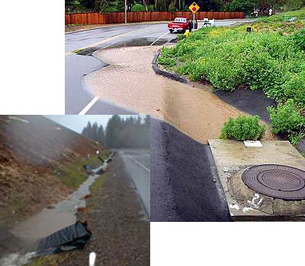
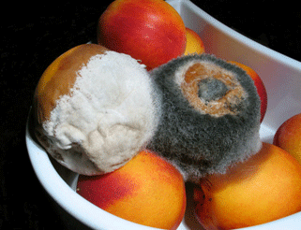
Curricula: Green Training Trade and Industrial Programs
Certified Indoor Air Quality Manager
Certified Indoor Environmentalist
Certified Microbial Investigator
Fundamentals of Solar Hot Water Heating
Home Energy Analyst
Intro to Building Energy Efficiency
Photovoltaic System Design & Installation
Weatherization Energy Auditor
Certified Compliance Inspector of Storm water
Certified Preparer of SWPPP
Storm water Subcontractor Short Course
Green Driving Techniques

Slide 11
Curricula: Sustainable Energy certificate
1.) Sustainable Energy Systems I
2.) Sustainable Energy Systems II
1. To develop a broad perspective and nuanced understanding of energy sources and flows.
2. To become well-versed in the current state of the art in energy conversion and storage, as well as near- and far-term technologies that may impact the field.
3. To gain the skills necessary to create projects utilizing novel ambient energy supplies, and to measure and monitor the energy usage in those projects.
4. To develop a larger-scale group project utilizing a currently available renewable energy supply.

Slide 12
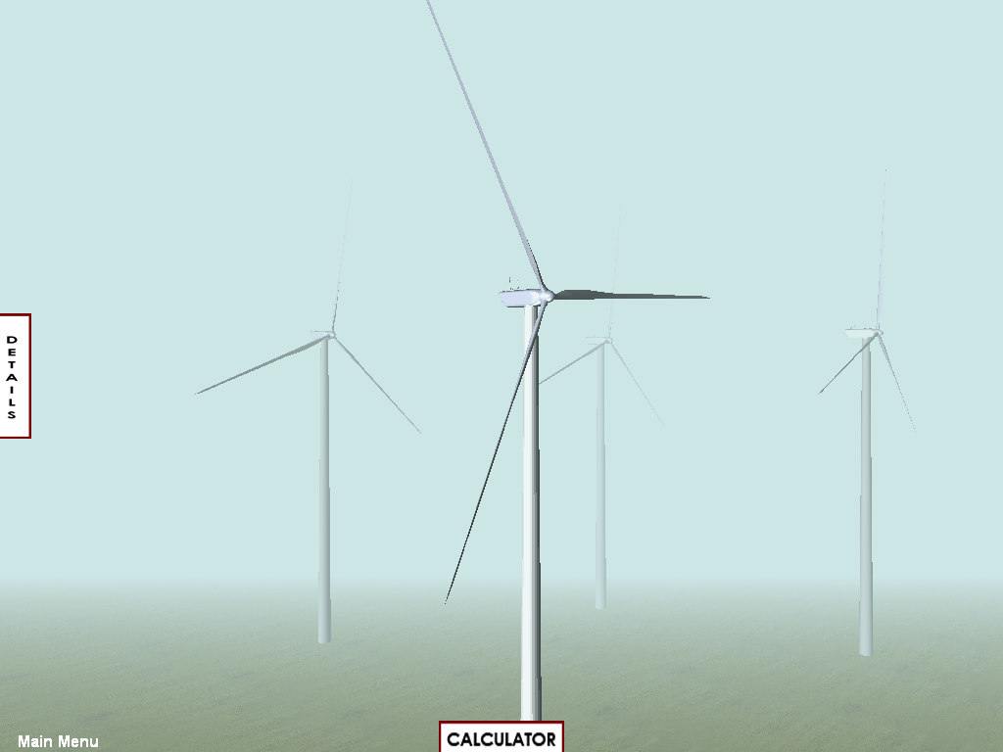
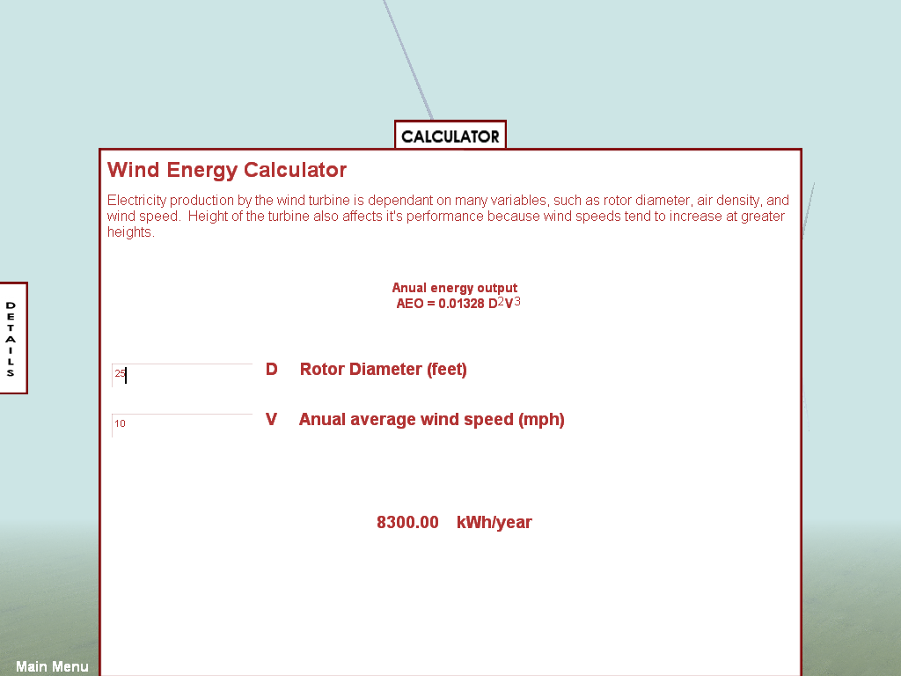
Middle/High School
NSF grant “Innovations in Engineering Technology Education”
Use of advanced learning tools in the college classroom and spark interest in engineering technology with middle & high school students
Introduce alternative energy in the K-12 system that will encourage / enable students to continue their education at BHC
Creation of a sustainable energy 3-D Simulator / Calculator
wind, solar, biomass, and geothermal
3-D rapid graphics
Development of a feature-rich interactive website entitled, “ Are you Ready?”
Engineering Technology Camp for teenagers June , 2009

Slide 13
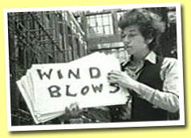
“The Answer, My Friend is Blowing in the wind”
Government mandates
Deregulated markets
Grant availability
Deregulation of electrical system in Illinois January 1, 2007
Projected 20-35% increase in electrical costs
Feasibility Study at BHC Main Campus

Slide 14
Status Quo

Slide 15
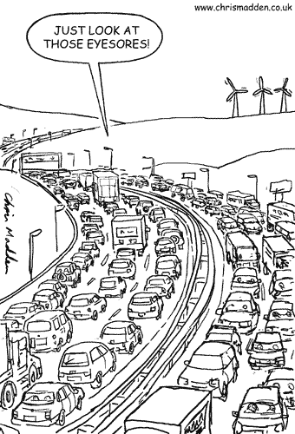
Expenditure Justification
Status Quo
$19.9 million over 30 years
Revenue
Generate $16.4 million + over 30 yrs
Net $9.2 million + over 30 yrs

Slide 16
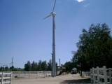
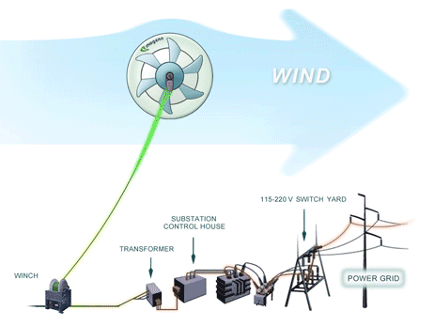
BHC Main Campus Options
20 Kw Package: ReDriven Manuf.
FD12.0-20k including generator, blades, flange
20 Kw ReDriven On-Grid Controller
4 PVI-6000 Inverters
3 Isolation Transformers
MSRP: $42,737.62*
Tower options:
20 Kw hydraulic tower 18M (59ft) - $13,891.92
20 Kw 24M, 30M, AND 36M (80,100,120ft)
*Prices do not include shipping and installation. (Total $100,000)

Slide 17
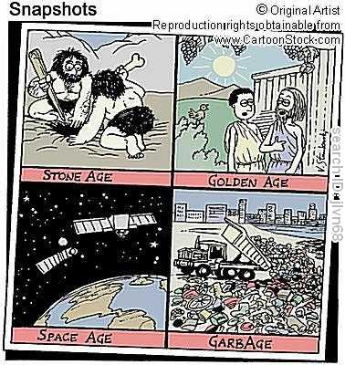
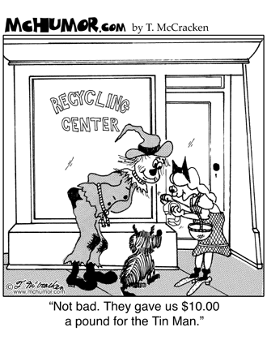
Questions
For more information
Black Hawk College
6600 34th Ave
Moline, IL 61265
Dr. Rose Campbell, VP
309-796-5043
John Kidwell, Director of Facilities
309-796-5258

